Slide 1
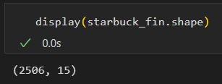
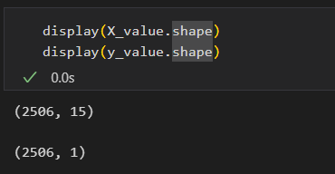
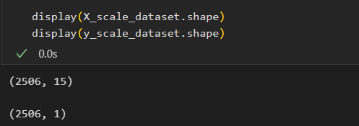
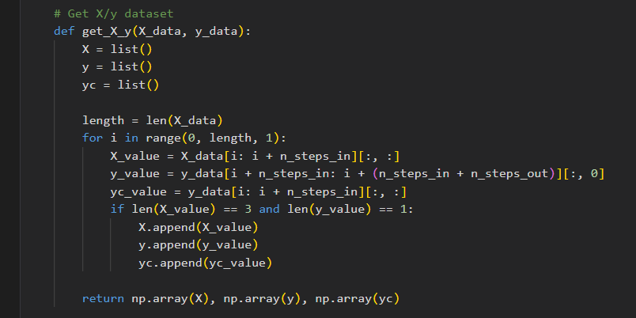
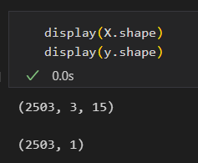

Overview of data preprocessing / modelling in GANs
1.) Original dataframe
5.) Getting training and testing data
starbuck_fin
Index
Closing
14 features
2,506 data points
2.) Defining X and y
X_value
Index
Closing
14 features
2,506 data points
y_value
Index
Closing
2,506 data points
3.) Normalization (by minmax scaler)
$$X_{scaled}= \frac{X−X_{min}}{X_{max} − X_{min}}$$
X_scale_data_set
Scaled Closing and 14 features
2,506 data points
Index
y_scale_data_set
Closing
2,506 data points
Index
get_X_y (x_scale_dataset, y_scale_dataset)
4.) Reshaping data
Given: step in = 3, step out = 1, features = 15
X
d1 : 15 features
d2 : 15 features
y
d3 : 15 features
d4 : Closing
d2 : 15 features
d5 : Closing
Index : 2503 data points
d3 : 15 features
Index : 2503 data points
d6 : Closing
d4 : 15 features
…
…
d2506 : Closing
d2503 : 15 features
d2504 : 15 features
d2505 : 15 features
Length : 2506

